Slide 1
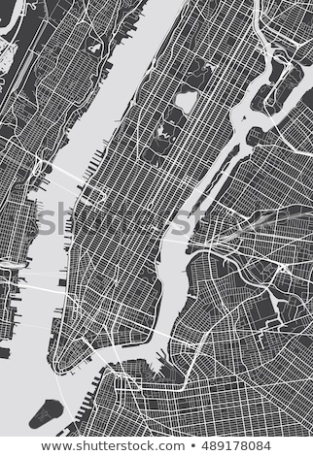

Predicting Affluency with YELP
Adriana Vesa
Varun Ganti
Gregory Rankel

Slide 2

Agenda:
Problem Statement
YELP Background
Data Collection
YELP AGI/ IRS Data
Defining Affluency
Data Cleaning
Expletory Data Analysis (EDA) :
Scatter Plots
Featured Engineering
Features Correlation
Models
Model Evaluation: Predictor – Decision Tree’s & Interpretable- Logistic Regression
Predicator: Confusion Matrix
Predicator: Feature Importance Confusion Matrix
Predicator: Visualization of Decision Tree - Adriana
Interpretable: ROC Curve & Histogram
Interpretable: Coefficient Correlation
Conclusion
Recommendations

Slide 3
Problem Statement
Can YELP dollar signs ($) predict affluency of a neighborhood.
For restaurants, it is: $ Price range $1-10 $$ Price range $11-30 $$$ Price range $31-60 $$$$ Price range $61+ It is also used on other reviews, such as hotels. Where $$=Moderate, etc

Slide 4
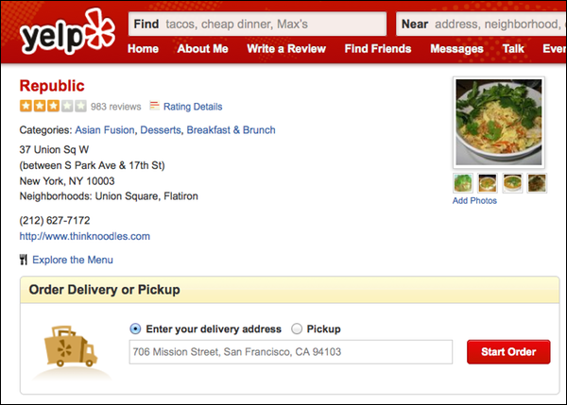
YELP Background
Business directory service and crowd-sourced review forum
User input information based on these businesses
Mainly used for restaurant rating and reviews

Slide 5
Data Collection
Yelp Data
IRS Data
2017 Tax Information
Zip Code
Adjusted Gross Income Stub
Adjusted Gross Income
Yelp API
Businesses
Search

Slide 6
Affluency: How are we defining it?
Taxable Income
_
Standard Deduction/ Itemized Deduction
Adjusted Gross Income
Affluent Rate > 50% = Affluent
Average AGI >200k
Total Average Income of Zip Code
Affluent Rate

Slide 7
Data Cleaning

Slide 8
EDA: Scatter Plot of Data points
Outliers
Outliers
file:///Users/gregoryrankel/Downloads/yelp_map.html

Slide 9
EDA: Scatter Affluency Rate per Zip Codes

Slide 10
EDA: Featured Engineering Trader Joe’s & Equinox

Slide 11
EDA: Featured Engineering Cluster
Elbow Point

Slide 12
EDA: Featured Engineering Cluster

Slide 13
EDA: Coefficients

Slide 14
Baseline - Model
~53%
Total Data points considered affluent: 4,298
Total Data points considered not affluent: 3,903

Slide 15
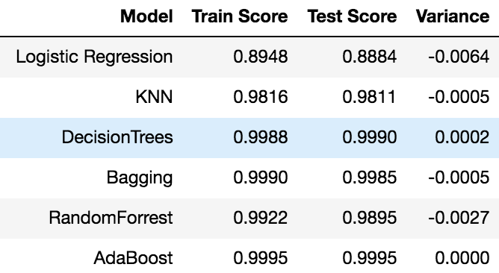
Modeling

Slide 16
Model Evaluation – Best Predictor: Decision Trees

Slide 17
Model Evaluation – Best Predictor: Decision Trees

Slide 18
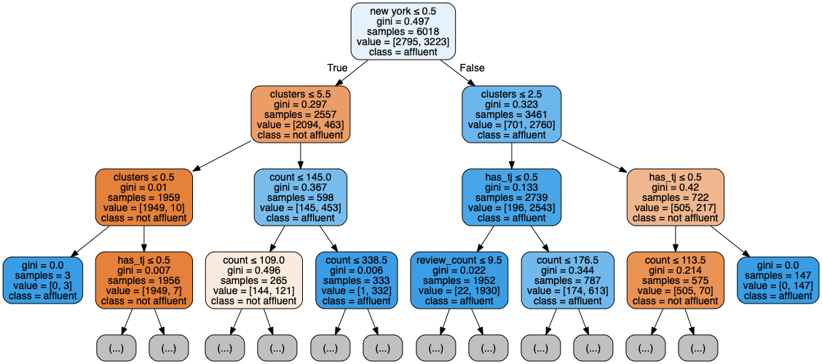
Model Evaluation – Best Predictor: Decision Trees

Slide 19
Model Evaluation – Best Interpreter: Logistic

Slide 20
Model Evaluation – Best Interpreter: Logistic

Slide 21
Conclusion
$ were not a good indicator of determining affluency of a neighborhood
Neighborhood itself weighed heavily on whether or not a neighborhood was affluent
Zip codes of New York City with under 109 businesses tend to be the least affluent
Even though not performing with price as key feature, still can engineer features customized for each specific city

Slide 22
Recommendations
Major Cities
Los Angeles
Chicago
Dallas
Smaller Market Cities
Sacramento
Philadelphia
Kansas City
Rural/Urban Area

Slide 23
Questions

